Slide 1
Tops tips for supporting speech sound development within the classroom
Nov 2018
Sarah Davis
Consultant SALT & Director of Services
Notes:
‹#›

Slide 2
Tops tips for supporting speech sound development within the classroom:
1) Hearing test 2) Time to talk without interruption 3) Use more natural repetition

Slide 3
Tops tips for supporting speech sound development within the classroom:
4) Ensuring parents are aware of which literacy schemes you use, such as KTC phonics, Jolly Phonics, Letterland, CBeebies Alphablocks 5) Understanding the use of Cued Articulation 6) Appreciating the difference between phonology and articulation

Slide 4
What is Cued Articulation
A set of hand cues for teaching the individual sounds in a word. The hand movements are logical – each hand movement represents one sound and the cue gives clues as to how and where the sound is produced.
It represents sounds visually to compliment auditory information
Teaches how to make sounds NOT letters e.g. Hand sign is the same for Cat, Choir and Kick
This is a link to a powerpoint on Cued Articulation
http://integratedtreatmentservices.co.uk/?resource=cued-articulation

Slide 5
Jane Passy devised the cues while working with a group of children with severe Speech and Language problems. Teachers found that not only did using the cues help the children with difficulties, but it raised the sound awareness skills of everyone in the class Jane developed the system to include 26 consonants and 23 vowel sounds

Slide 6
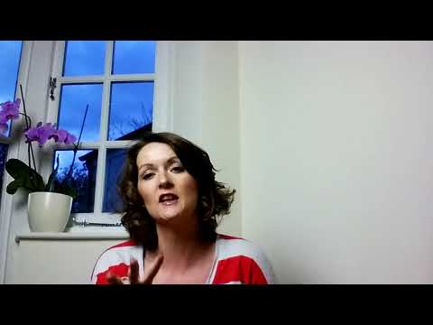
For more information you can watch these 2 videos.

Slide 7
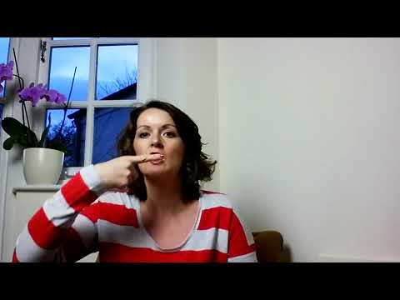

Slide 8
Tops tips for supporting speech sound development within the classroom:
7) Providing parents with good resources rather than leaving them to source their own 8) Labelling around the classroom and some support on sight reading 9) Calling upon you SLT for help and being aware of what approaches you might ask them to consider - Talk Tools, The Nuffield Dyspraxia Programme, Cued Articualtion. 10) Understanding the use of Talk Tools

Slide 9
What is Talk Tools
Talk Tools is an oral motor placement therapy approach. The approach incorporates sensory and tactile input, by using a range of specifically designed tools. The multi sensory approach consists of a range of hierarchies and programmes to develop and strengthen key motor skills, such as Jaw stability, lip closure and tongue elevation and also to improve feeding skills. For more information you can go to our website http://integratedtreatmentservices.co.uk/our-approaches/speech-therapy-approaches/talk-tools/

Slide 10
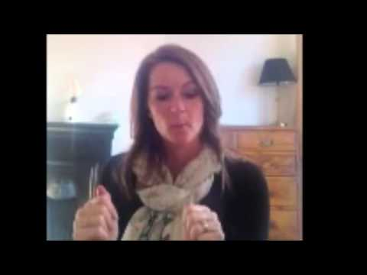
Talk Tools - an introductory video

Slide 11
Tops tips for supporting speech sound development within the classroom:
11) Being aware of language development and considering using Colourful Semantics to support this skill. 12) Be aware of the age timeline for development of speech sounds 13) Referral to a Speech and Language Therapist can be made by parents or yourselves directly to the SLT department it does not need to come through a GP.

Slide 12
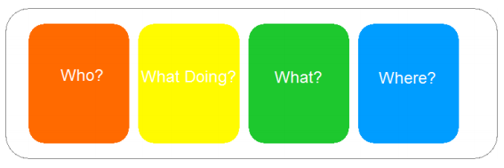
What is Colourful Semantics?

Slide 13
Training in Colourful Semantics?
We can provide training on-site or at one of our centralised training dates with Alison Bryan the programme creator
Email us on training@integratedtreatments.co.uk for more information or go to our website here http://integratedtreatmentservices.co.uk/our-clients/schools-academies/colourful-semantics-training/

Slide 14
Speech Sound Development Timeline
Sound | Approximate age at which children can normally produce sounds:
 | 50% of children | 90%of children
Common vowel sounds | 1.5 - 2 years | 3 years
p, b, m, n, t, d, w. | 1.5 - 2 years | 3 years
K, g, f, h, y. | 2.5 – 3 years | 4 years
ng, s | 2.5 – 3 years | 5 years
l | 3 – 3.5 years | 6 years
sh, ch, j, z, v | 3.5 – 4.5 years | 6 years
r | 4.5 – 5 years | 7 years
th (in thigh), th (in the) zh (in vision) | 4.5 – 5 years | 7 years

Slide 15
Speech sound development
Children’s attempts at producing speech sounds can continuously improve until they get it right
 | 2 year old | 3 year old | 4 year old
spoon | bu | poon | spoon
cup | tu | tup | cup
hospital | obi | hodel | hospital

Slide 16
Thank you for watching
If you would like to provide us with any feedback or request assistance with implementing any approaches or ideas within your settings or sessions do get in touch via our contact details on the next slide.
We can provide training or direct therapy support to therapists and teaching staff
CONTACT US

Slide 17
Here’s to a great year ahead!
Do let us know if there are other topics you want to hear about!

Slide 18
Tel: 0845 838 2921
www.integratedtreatmentservices.co.uk
training@integratedtreatments.co.uk
Join us on our social media
/IntegratedTreatmentServices
@ITStherapy
/integrated-treatment-services
Copyright © 2013 Integrated Treatment Services

