Slide 1
Language Outcome in Autism: Randomized Comparison of Joint Attention and Play Interventions

Slide 2
Introduction
Joint Attention and Symbolic Play skills develop during the first 2 years of life.
Joint Attention skills include sharing attention with others by showing, pointing and coordinated looking between object and people.
Symbolic Play skills include representational use of objects – pretending one object represents another
For example:
Imagining that dolls have personal attributes & abilities or as when a doll drives a car.
(Kasari, 2006)

Slide 3
Joint Attention
JA ability is associated with language development
Longitudinal studies show greater ability to initiate and respond to JA predicts language skills 1 year (Mundy, Sigman, & Kasari, 1990), 5 years (Charman et al., 2005), and 8 years later (Sigman & Ruskin, 1999)
Responding to point of experimenter was the greatest predictor for language (Mundy et al., 1990; Sigman & Ruskin, 1999)
Joint focus of attention supports language development (Baldwin,1991)

Slide 4
JA skills can be taught to children with autism
By the age of 10–13 years, as many as one quarter to one half of children with autism still will not have developed language (Lord & Schopler, 1989; Sigman & Ruskin, 1999).
Young children with autism have considerable deficits in social communication skills (Kasari, 2006)
Children with autism who actively follow and share attention with adults have sophisticated language abilities (Charman et al., 2003; Dawson et al., 2004; Loveland & Landry, 1986; Mundy, Sigman, Ungerer, & Sherman, 1986).
Whalen and Schreibman (2003) found that when they directly taught children to respond and initiate JA actions, four out of five 4-year-old children with autism improved.

Slide 5
http://www.youtube.com/watch?v=tif4U3OjT2M
http://www.youtube.com/watch?v=10xh7QdQOns&list=FLk5bMFgY-ffuOeG1NDELlqA

Slide 6
Present Study
This study by Connie Kasari et al, 2008 examined the long term effects of their previous RCT study (JA and SP in young children with autism), which was conducted in 2006.

Slide 7
Aims of the Study
Do targeted interventions of JA or SP significantly affect children’s language outcome 6 and 12 months later?
By controlling for different treatments, can child characteristics differentially predict language outcome?
Stability and growth of skills that were directly targeted in intervention, JA and SP skills were examined
Whenever possible, composite measures of JA and SP skills were created to account for children’s average performance across settings

Slide 8
Participants
56 children diagnosed with Autism by Autism Diagnostic Interview- Revised (ADI-R) and Autism Diagnostic Observation Schedule (ADOS).
Inclusion criteria:
Age range 3-4 years old
Accessible for follow-up
No seizure disorder or other medical conditions

Slide 9
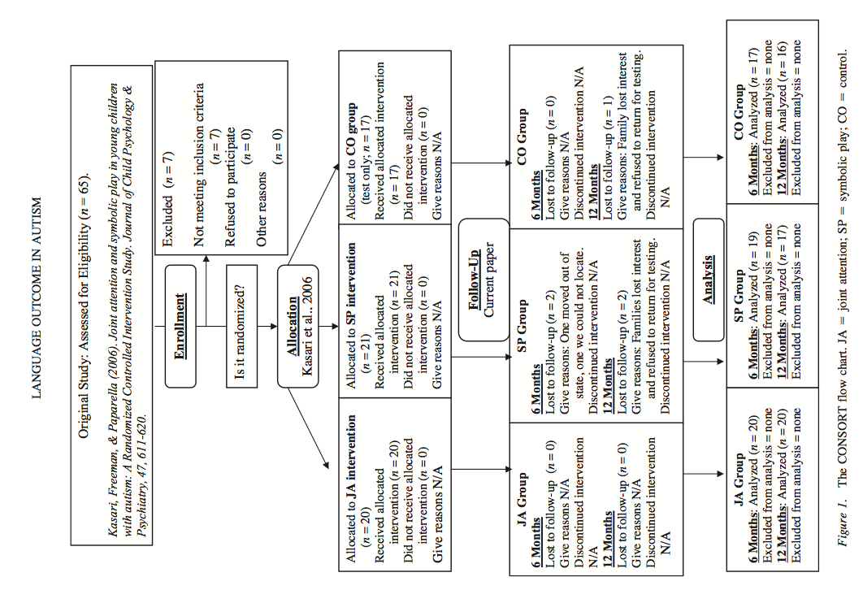

Slide 10
Intervention
All children participating in this study attend the same applied behavior analysis ABA- based hospital day treatment early intervention program EIP and followed atypical pre-school curriculum.
EIP:
30 hours of treatment /week.
offered multidisciplinary assessment & recommendations for intervention at home & school.
Six 30 min period of 1:1 or 1:2 ABA sessions, snack, lunch, three 30 min reset period and dispersed self-help teaching sessions.

Slide 11
Intervention
Interventions take place in the same play room with the same set of toys.
Structured:
1:1 session for 30 min/day
5-6 weeks depending on the child stay in the EIP.
Direct instruction at the table.
Naturalistic milieu- based instruction on the floor.
Interventions were delivered by 5 Trained experimenters (graduate students in Educational Psychology with experience in the field of autism)

Slide 12
Difference Between JA and SP
Joint Attention Intervention | Symbolic Play Intervention
Focused on teaching joint attention skills. Incorporate imitation of the child and engineered play routines. Examine responding skill initiation by pointing, showing, giving and coordinate joint look. | Focused on improving symbolic play skills. Object combinations that were increasing more symbolic but were not contingent upon shared attention between adult and child.

Slide 13
Intervention Approach
Each child’s first treatment goal was determined from the assessment result.
Table Activity:
5 to 8 min discrete trail training to particular treatment goal.
Experimenter sat across from child and shaped the targeted joint attention (or play) skill while engaging the child in social interaction.
The instruction was primarily adult-directed.
Principles of ABA were followed, including the use of hierarchical prompts (verbal prompt, model, physical prompt) and positive reinforcement used to achieve child's appropriate response.
(Kasari, 2006)

Slide 14
Floor Activity:
20 min using naturalistic milieu instruction on the floor to enhance generalization and flexible learning.
The same skill (play or joint attention) was targeted with an expanded set of toys.
Child direct the session and targeted skill still shaped by experimenter used techniques while sitting close to the child and making eye contact eye contact such as:
Taking about what the child was doing
Repeating back what the child said
Expanding on what child said
Giving corrective feedback
Making environment adjustment to engage the child.
(Kasari, 2006)

Slide 15
Joint Attention Skills (Kasari, 2006)
Initiation Joint Attention Coordinated Joint Look Showing Give to share Proximal Point Distal Point | Child looks between adult & a toy to share attention. No more than 3 sec must separate the look between the toy & the adult. Child has object in hand and holds it towards adult to share attention. Child does not give toy to adult. Child gives toy to adult. The child must make a clear attempt to give the toy to the adult. Just a general thrust or throw in the direction of the adult is not acceptable. Child does not want adult help. Child gives purely to share, e.g. for adult to look at a toy or for adult to take a turn with a toy. Child points to an object within 4 inches of object purely to share interest with the adult. Child’s finger does not need to be touching object. Child points to an object which is more than 4 inches away from pointing finger purely to share interest with the adult. Child does not want adult to act on the toy.

Slide 16
Joint Attention Skills
Responsive Joint Attention Following proximal point Following distal point | After adult points (to object within 4 inches of pointing finger), child responds with an attention focus. The child’s eye-gaze shifts to focus on the object that the adult is pointing to. Child follows adult distal point (at least 4 inches away from object). The child’s eye-gaze shifts to focus on the object that the adult is pointing to.

Slide 17
Play Skills(Kasari, 2006)
Level | Categories | Definition
1 | Indiscriminate actions | All objects are treated alike (e.g., all objects are mouthed)
2 | Discriminative actions | Differentiates among conventional objects, preserving their physical characteristics, or single objects (e.g., rolls round beads, squeezes stuffed animal)
3 | Takes apart combinations | Separates configurations of objects (e.g., takes all pieces out of puzzle)
4 | Presentation combinations | Re-creates combinations of objects according to their presentation configuration (e.g., puts puzzle pieces into puzzle; nests the nesting cups)
5 | General combinations | Creates combinations of objects that result in simple, non-specific configurations such as container/contained relations (e.g., puts beads & puzzle pieces in the cup)
6 | Pretend self | Relates objects to self, indicating a pretend quality to the action (e.g., brings empty cup to mouth to drink)
7 | Specific combinations Physical attributes | Preserves unique physical characteristics of objects in the (physical attributes) configuration (e.g., stacks nesting cups, strings beads)

Slide 18
Level | Categories | Definition
8 | Child as agent | Extends familiar actions to doll figures, with child as agent of the activity (e.g. extends cup to doll’s mouth)
9 | Specific combinations Conventional attributes | Preserves unique conventional characteristics of object in the (conventional attributes) configuration (e.g., places cup on saucer; places string of beads on self)
10 | Single scheme sequences | Extends same familiar action to two or more figures (e.g., extends cup to baby doll, to stuffed lamb, to interactant)
11 | Substitutions | Uses one object to stand in place for another (e.g., puts bowl on head for a hat)
12 | Substitutions without object | Pretends to use something that is not there (e.g., shakes an imaginary salt shaker)
13 | Doll as agent | Moves doll figures as if they are capable of action (e.g., moves figure to load blocks in a truck; puts mirror into doll’s hand as if to see itself)
14 | Multi-scheme sequences | Extends different actions to same figure (e.g., feeds doll with spoon, wipes it with cloth, then puts to bed)
15 | Socio-dramatic play | Adopts various familiar roles in play theme (e.g., plays house, assigning the various roles)
16 | Thematic fantasy play | Adopts roles of fantasy characters (e.g., plays ‘‘Superman’’ or ‘‘Wonderwoman’’, assigning the various roles)

Slide 19
Mastery Criteria
If the child demonstrated the goal in 3 different ways( type) at 3 times at both table and floor.
The behavior was considered to be mastered only if initiated by the child and not prompted or suggested by the experimenter.

Slide 20
Rationale for Intervention
Understanding mental representations of others (Baron-Cohen, Tager-Flusberg, Cohen, 1994; Hobson, 2002)
Significant associations between JA and later language abilities ( Charman et al 2003; Loveland and Landry, 1986)
Absence of JA and SP puts children with autism at high risk (Charman et al., 2003)

Slide 21
Supportive Evidence
Improvements in symbolic play skills as a result of EIP focused on play and social-communication skills
(Rogers and Lewis, 1989)
7 preschool children were taught SP skills and showed significant increase in amount and complexity of these skills (Stahmer, 1995)
Improvements in language development as a result of a parent implemented intervention on joint attention skills (Drew et al, 2002)
Improvements in responding in joint attention gestures were observed in 5 preschool children with autism who were taught JA skills (Whalen et al, 2003), 4 out of 5 improved in initiation of JA gesture

Slide 22
Outcome Measures
Testers independent of treatment staff and blind to child group assignment assessed the children.
To validate clinical diagnosis of Autism: ADOS and ADI-R
Battery of tests:
Mullen Scales of Early Learning
Reynell Developmental Language Scales
Early Social-Communication Scales
Structured Play activities

Slide 23
Once the children from all three groups (JA, SP, and CO) left the EIP and RC experimental treatment, they were followed with testing at 6 months and 12 months post intervention
At 6 and 12 months post intervention, the Reynell, ESCS, Structured Play, and mother– child interaction measures were repeated.
At 12 months, the Mullen was readministered.
Parents were given the demographic questionnaire at each testing

Slide 24
Early Social-Communication Scales:
Repeated at all four time points (entry, exit, 6 months, and 12 months)
The child and tester sit facing each other at a table with a set of toys in view but out of reach of the child (Seibert, Hogan, & Mundy, 1982).
Toys include several small wind-up and hand-operated mechanical toys, a hat, comb, glasses, ball, car, balloon, and book.

Slide 25
The coders overlapped coding on 20% of the sample, and reliability was estimated using two-way mixed effects model (consistency definition)—single rater intraclass correlation coefficient (ICC) value.
These coefficients were reported after each variable (major variables were frequency of initiations and responses of JA behaviours).
Initiations included coordinated looking (.77), distal pointing (.80), proximal pointing (.78), and showing (.79).
Responses included responding to experimenter points (.81) and gaze (.83).
The average ICC for initiations was .79, and for responses the average ICC was .82.

Slide 26
Structured Play
This test was repeated at all four time points (entry, exit, 6 months, and 12 months). The child is presented with sets of toys at a table (Ungerer & Sigman, 1981). Toys consist of three different-sized dolls, doll furniture, baby bottles, a tea set, a dump truck, a garage, blocks, a piece of paper, three pieces of sponge, a telephone, a brush, and a mirror. The entire play interaction lasts approximately 15–20 min. The child’s play behaviors are videotaped and later coded
Variables used in the analyses were (a) functional play types, (b) SP types, and (c) play level

Slide 27
Mastery was defined as the highest spontaneous play level attained with at least three different types/exemplars of that level. Play level ranged from 1 ( physical and conventional combinations) to 14 (sociodramatic and thematic/fantasy play; Lifter, Sulzer-Azaroff, Anderson, & Cowdery, 1993; Ungerer & Sigman, 1981)
Reliability was calculated between two independent coders blind to group status and testing order for 12 subjects

Slide 28
Mother–child interaction. A 15-min videotaped interaction was collected for each child at all four time points (entry, exit, 6 months, and 12 months). Mothers were asked to play with their child as they normally would at home using a standard set of toys (including dolls, dishes, puzzles, truck, and blocks).
First, the child’s play behaviors during the mother– child interaction were examined and coded again for types of functional and SP acts (Lifter et al., 1993). A weighted score was used to create the mastered play level score to control for differences in opportunities that may have occurred between dyads.

Slide 29
Second, the mother– child interaction was coded for JA skills
(ICC reported next to individual variables). The coding identified (a) amount of time (in seconds) in which parent and child were jointly engaged and interactive around objects (.65; Bakeman & Adamson, 1984); (b) who initiated joint engagement (parent or child, .95); and the child’s frequency of JA skills (e.g., coordinated looks, .76; pointing, .77; and showing, .78). The overall ICC between two independent coders blind to group status was .78.

Slide 30
Parents were asked to complete a simple demographic form that asked for their child’s birth date and ethnicity; the parents’ age, occupation, and highest level of schooling completed; and the child’s current and previous service and for how long the service had been received. Measures of overall service hours and speech service hours were calculated.
This yielded a single number for the hours of service the child had received over the past year and a single number specifically for the hours of speech therapy the child had received over the past year.

Slide 31
Outcomes: Effectiveness of Intervention
Growth in Language as a Function of Treatment
effect of intervention on growth in expressive and receptive language was examined, controlling for mental age at onset
Significant difference among the groups in their rate of change in expressive language,
Both groups showed significantly greater growth in expressive language over time than did the control group

Slide 32
No significant effect of intervention on growth in receptive language from pre intervention to 12 months post intervention.
findings suggest that focusing on joint engagement (whether in the context of learning JA skills or SP skills) with young children with autism results in better language outcomes than persisting solely with ABA activities.
number of speech hours was not significantly associated with language outcome.
children receiving interventions on JA or SP continued to show growth and generalization in these skills after the experimental interventions ended and continued to significantly outperform the control group.

Slide 33
Children in the SP intervention demonstrated stronger effects in all areas at the 12-month follow up, including their growth of JA skills.
As children learned to play symbolically with toys, their JA skills developed without direct teaching

Slide 34
The fact that SP skills did not improve significantly for the JA group suggests that SP skills may require direct teaching, and are not as susceptible to collateral gains.
Thus the differences between the control group and the two experimental groups are greater a year later than they are at the immediate end of treatment. Such findings have been noted in other studies (Yoder & Warren, 2002; Weiss, Harris, Catron, & Hans, 2003).

Slide 35
Similar to other studies, children who are high functioning may progress faster regardless of treatment model (Ozonoff & Cathcart 1998).
Differences in treatment outcome were looked at by examining the lowest performing children, those with expressive language ages below 20 months (and producing fewer than 5 spontaneously initiated words). Children with this profile made greater language growth if they were randomized to the JA intervention than to the SP or control group.

Slide 36
These individual differences in response to treatment are critically important to consider since about one half of children with autism fail to develop any meaningful language (Lord & Schopler, 1989; Wetherby & Prizant, 1992).
One reason why the JA treatment condition facilitated language development better for children who were developmentally young may be that the shared context of a joint engagement state allows a child to focus on a joint activity and on language without having to engage in reciprocal communication (as seen in typical development)

Slide 37
By staying within the child’s current focus the adult may reduce the demand for the child to shift attention, thus maximizing the child’s ability to attend to new language (Adamson et al., 2004).
In summary, this study significantly improved JA and SP skills in young children with autism. Both experimental interventions had significant effects on the growth of later language skills

Slide 38
Generalizability of these findings is enhanced because children were included in the study regardless of initial developmental abilities thus reflecting the range in ability of children diagnosed with autism in the general population.
Findings suggest that interventions with young children with autism should focus on both JA and SP skills as they have significant effects on language acquisition.

Slide 39
Limitations of the study
Extraneous variables: maternal education, time scale
Combination of discrete trials and child-led activities, children in EIP programme
Correlation vs causation?
No improvement in receptive language skills?
Limited research on joint attention in client populations

Slide 40
Follow-up study
80% of children achieved functional spoken language
Focusing on joint attention and symbolic play had long-term spoken language outcomes
(Kasari et al, 2010)

Slide 41
References
Kasari, C., Freeman, S., & Paparella, T. (2006). Joint attention and symbolic play in young children with autism: A randomized controlled intervention study.Journal of Child Psychology and Psychiatry, 47(6), 611-620.
Kasari, C., Paparella, T., Freeman, S., & Jahromi, L. B. (2008). Language outcome in autism: randomized comparison of joint attention and play interventions. Journal of consulting and clinical psychology, 76(1), 125.
Kasari, C., Gulsrud, A. C., Wong, C., Kwon, S., & Locke, J. (2010). Randomized controlled caregiver mediated joint engagement intervention for toddlers with autism. Journal of autism and developmental disorders, 40(9), 1045-1056.
Kasari, C., Gulsrud, A., Freeman, S., Paparella, T., & Hellemann, G. (2012). Longitudinal follow-up of children with autism receiving targeted interventions on joint attention and play. Journal of the American Academy of Child & Adolescent Psychiatry, 51(5), 487-495.

Slide 42
Discussion

Slide 43
Thank You

